Slide 1
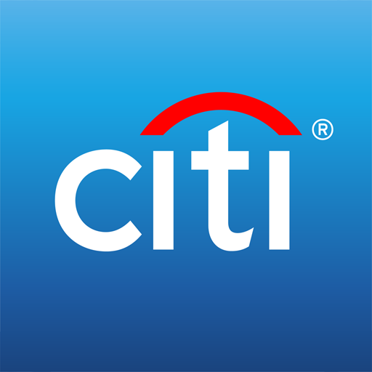
Citi Bank – Customer Session Portal
Customer Session Portal

Slide 2
Citi Bank
Mentees:
Digvijay Singh Rathore. Purushotham Reddy Pothala. Dibakar Hazra. Sunith Kumar Patnaik. Durgam Prasanth. Ruchika AGS.
Venkata Arshitha Karodi. Nimmala Shiva Shankar. SaiKiran Achari. Madhusudhan J. Thakur Rohith Singh. Matthew Buckle A.
Mentors: Gopinath B Shashi Kumar S Koti. Binuraj E K.

Slide 3
Citi Bank
Problem Statement
To build a portal which will be the landing page for the customers who will be advised with the portfolio related activities from the Relationship Manager. RM should be able to manage the sessions based on the customer’s availability and requests.
Expected outcome
The Customer Session Portal will centralize communication, making it easy for relationship managers(RM) to handle sessions. It will improve customer-RM communication, and ultimately enhance customer satisfaction, by advising on portfolio and wealth, with better customer experience.

Slide 4
Citi Bank
Technology Stack:
Programming Language: Java. Framework: Spring Boot with RESTful API Database: MySQL Testing: JUNIT5 Libraries: RESTful, Lombok Frontend Framework: Angular JS Frontend Library: Angular Material

Slide 5
Citi Bank
Project Activities
Stage 1: Requirement Gathering Interact with stakeholders to gather requirements and estimate project deliverables. Stage 2: Pre-requisites and Grooming Prepare the project environment and collaborate with design and testing teams. Understand functionality, biz logic, and design. Design plan approval. Create comprehensive test cases. Set up development environment. Install necessary tools (IDEs, DB, Postman, SonarLint). Design database tables. UI-specific prerequisites.

Slide 6
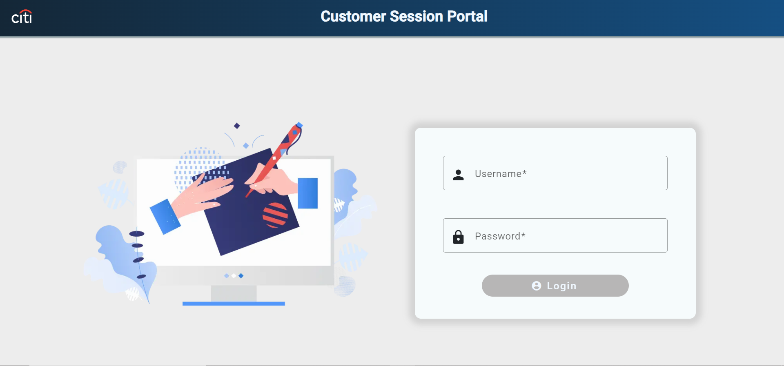
Citi Bank
Portal Pages
Login Page
RM login page with authentication.
RM login with password.
Display RM username on successful login.

Slide 7
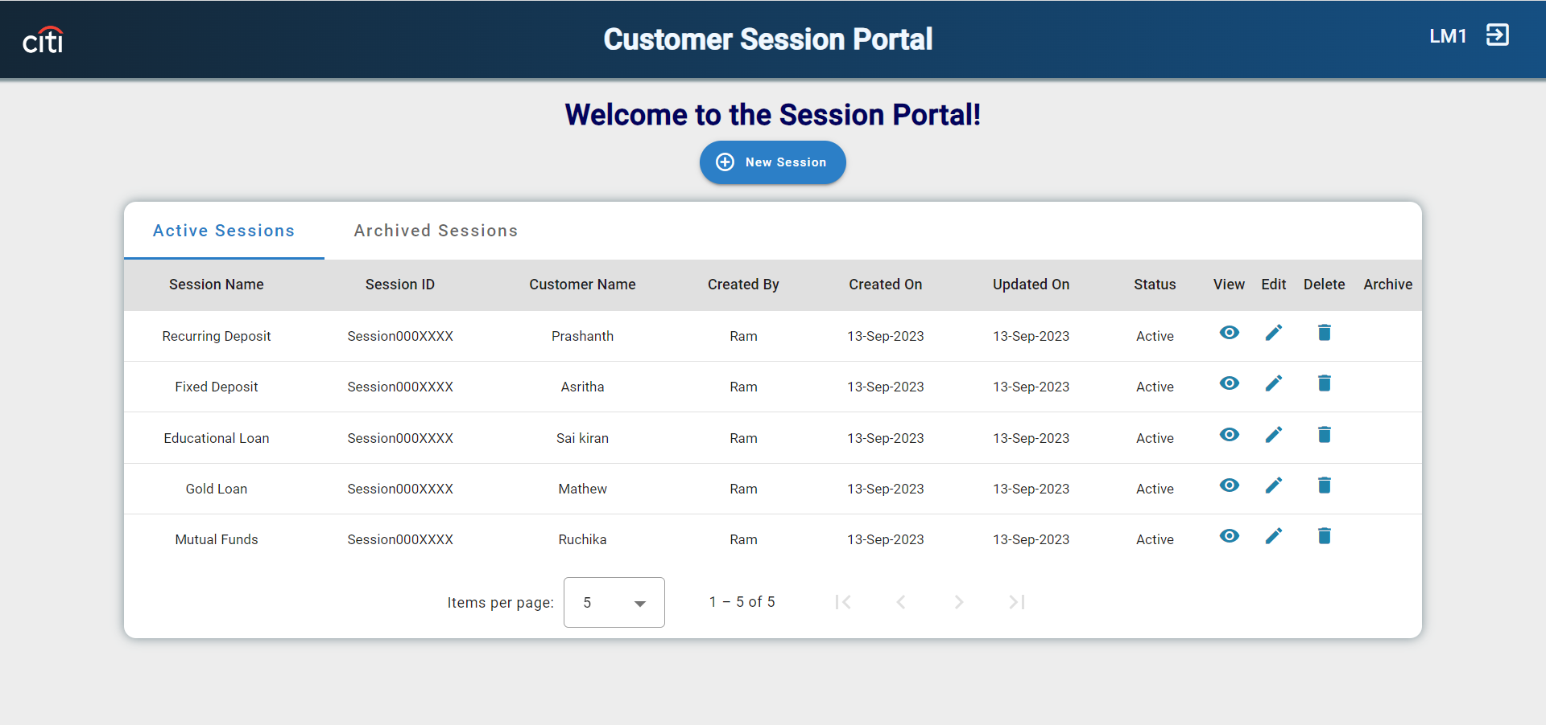
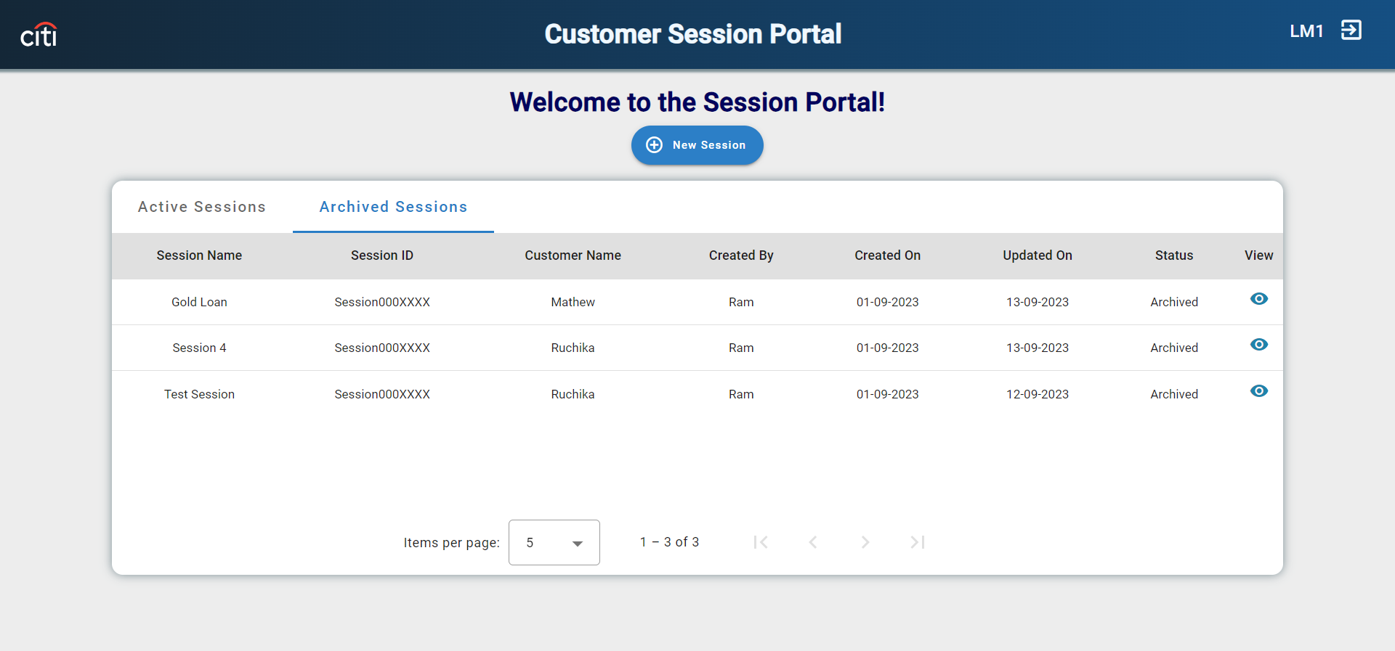
Citi Bank
Dashboard Page. Central hub for managing customer sessions. Tabs : Active and Archive. Archive Functionality: It will be enabled once the last updated date duration is 10 days before the current date.

Slide 8
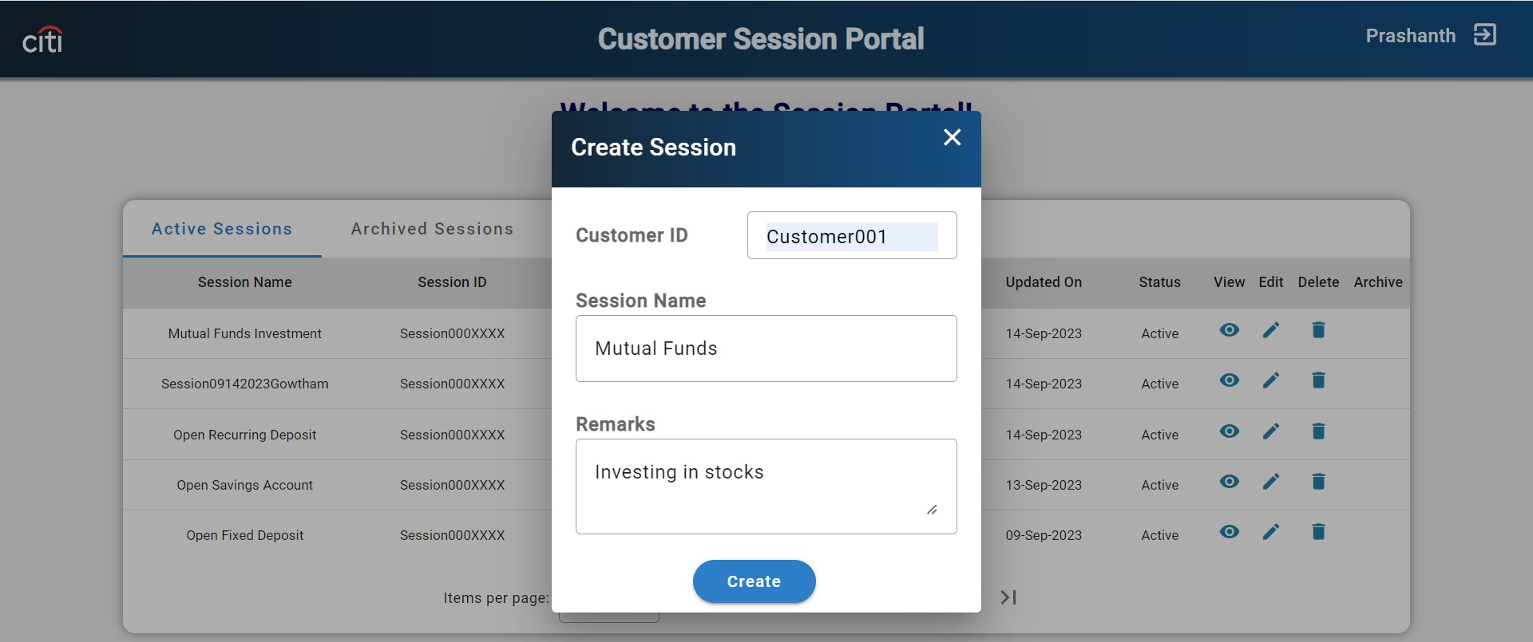
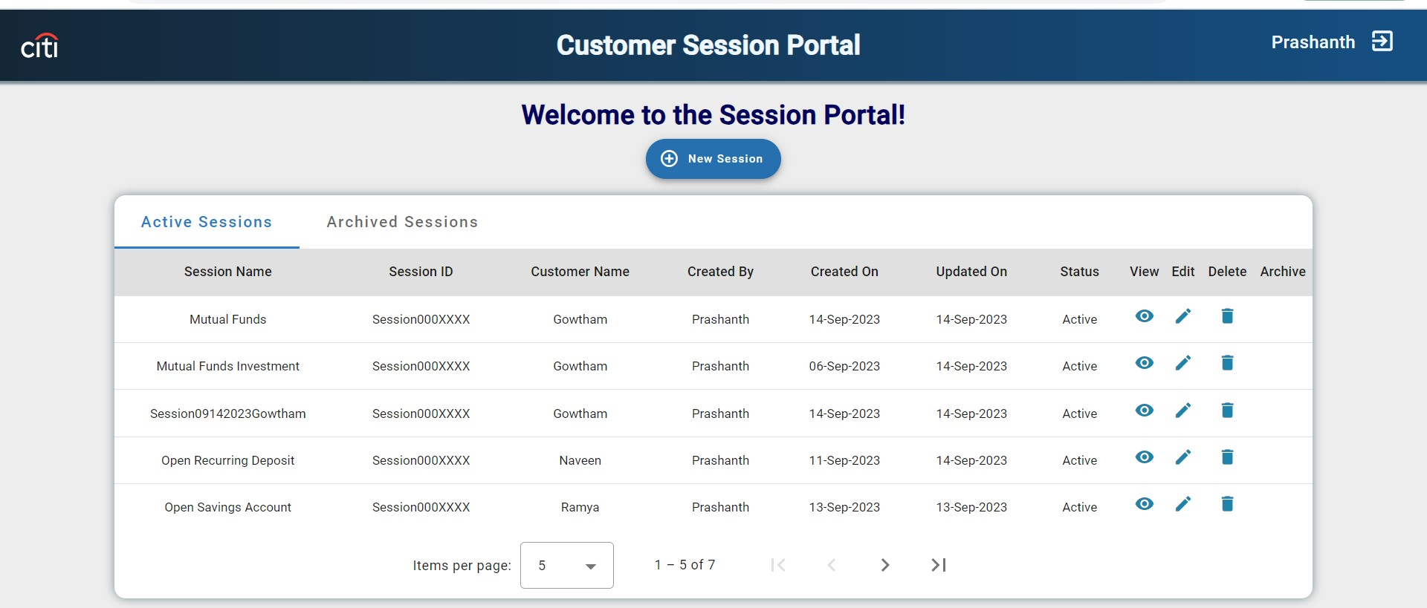
Citi Bank
Create Session Create Functionality : On Click of New Session it will display one Dialog box to create a session.

Slide 9
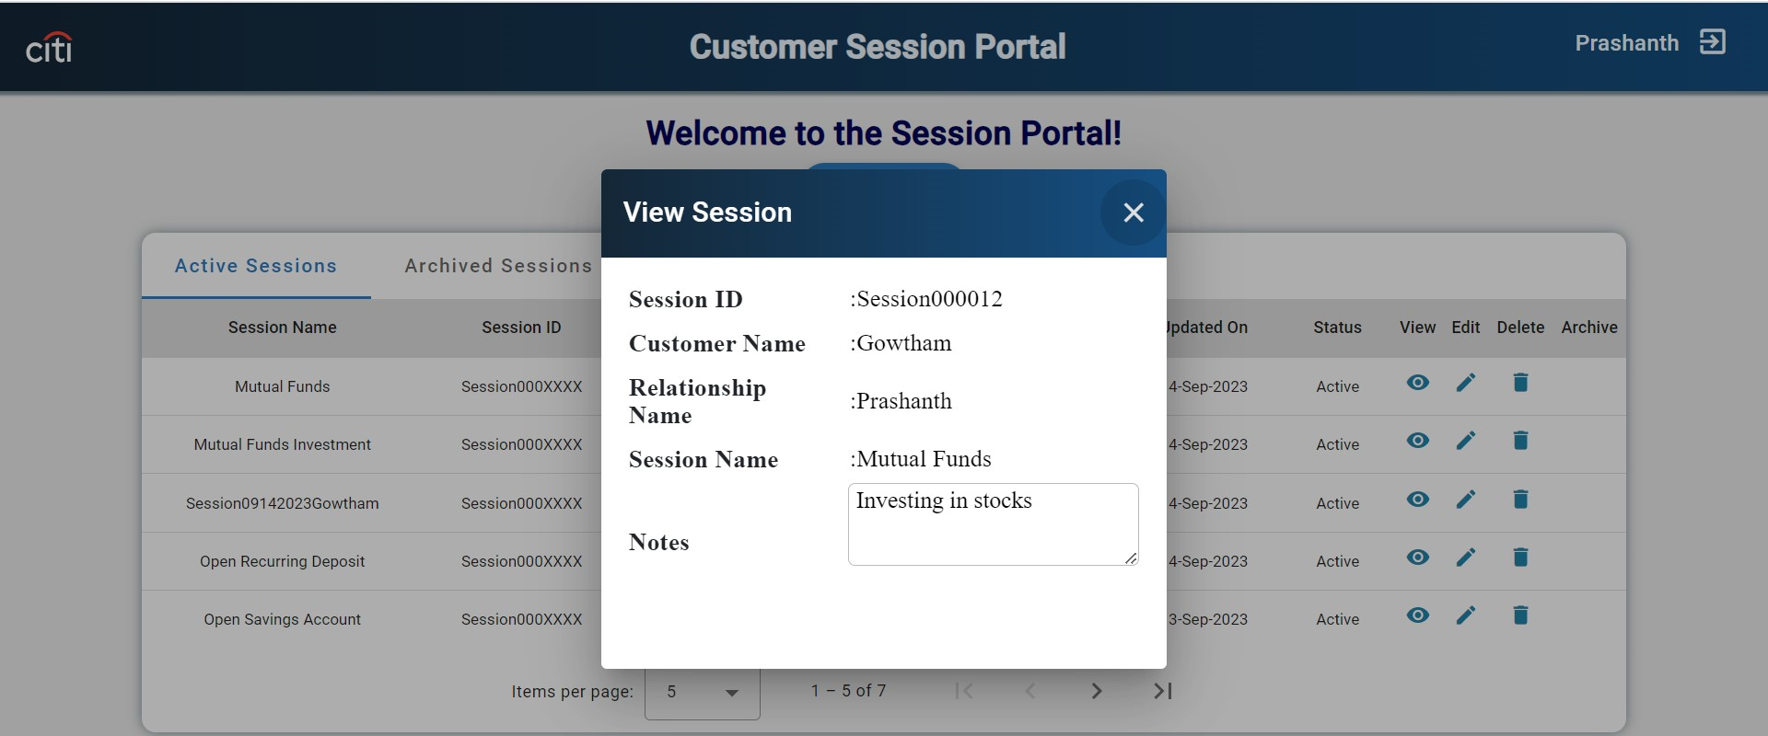
Citi Bank
View Session View Functionality : On Click of view icon it will display information about specific session.

Slide 10
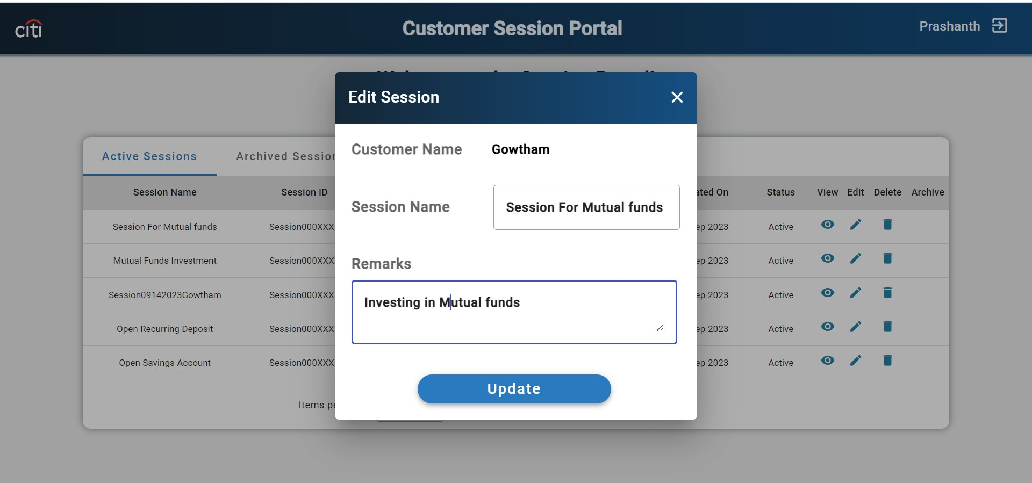
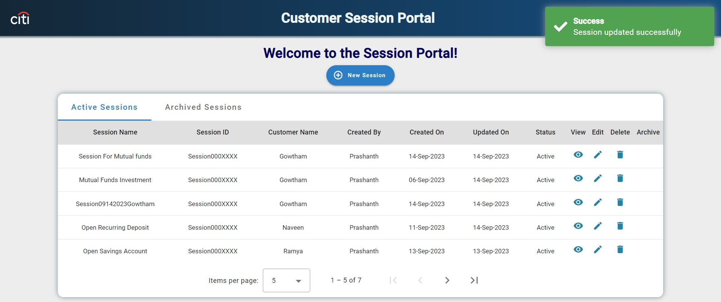
Citi Bank
Edit Session Edit Functionality :On Click of edit icon it will display a dialog box to edit the session.

Slide 11
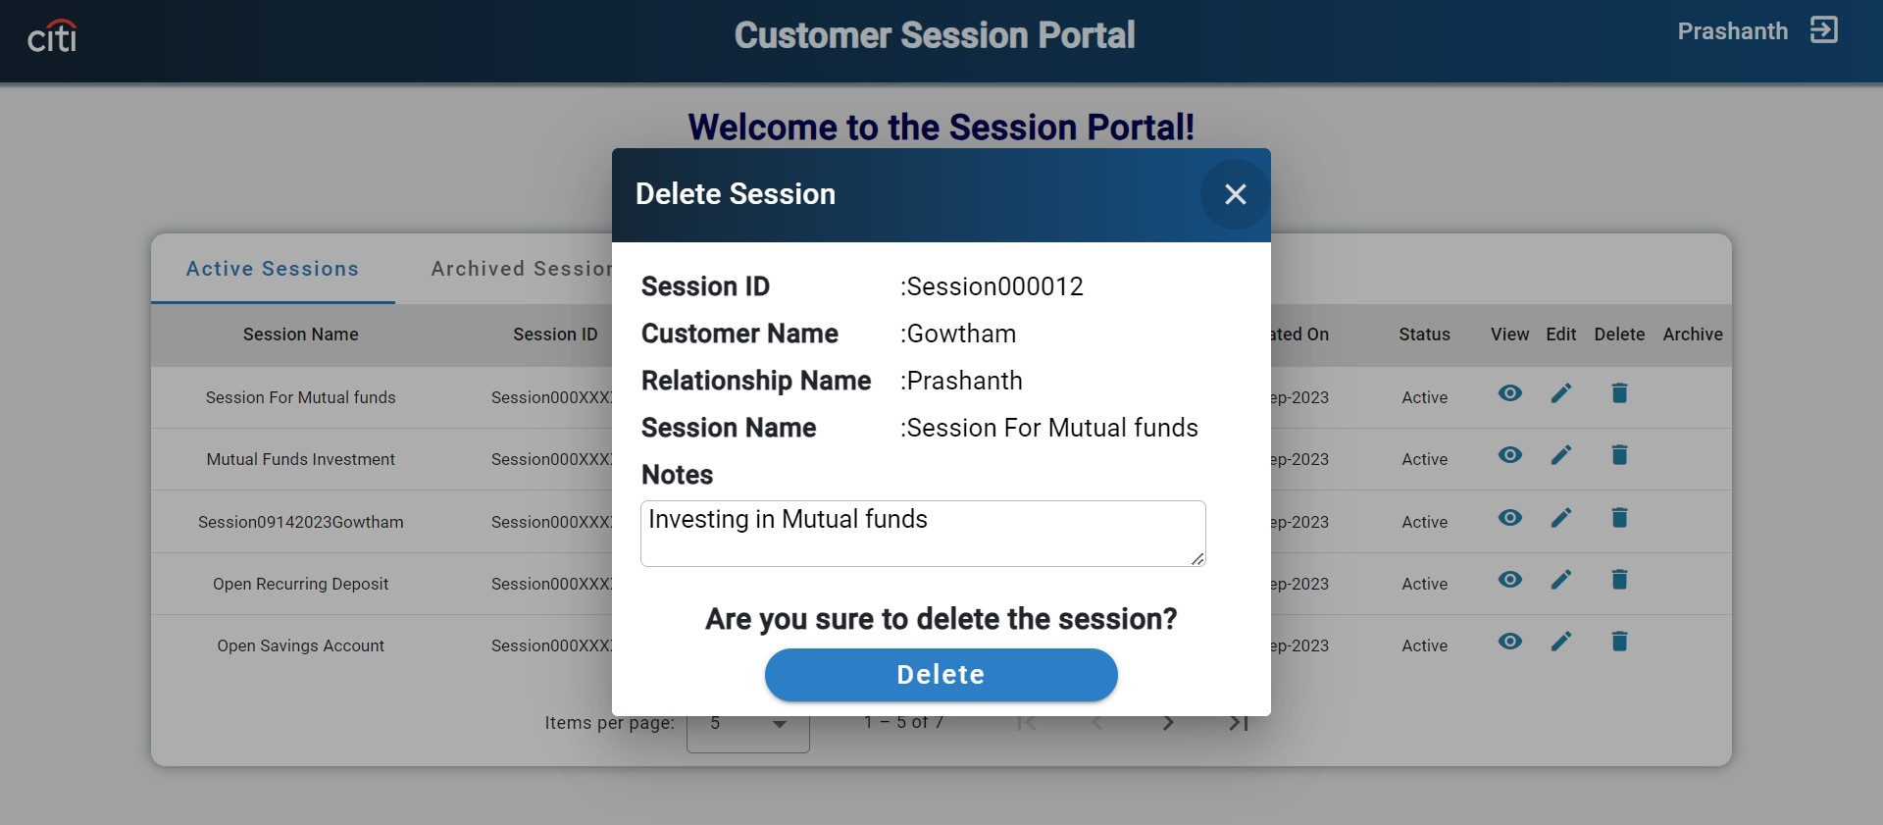
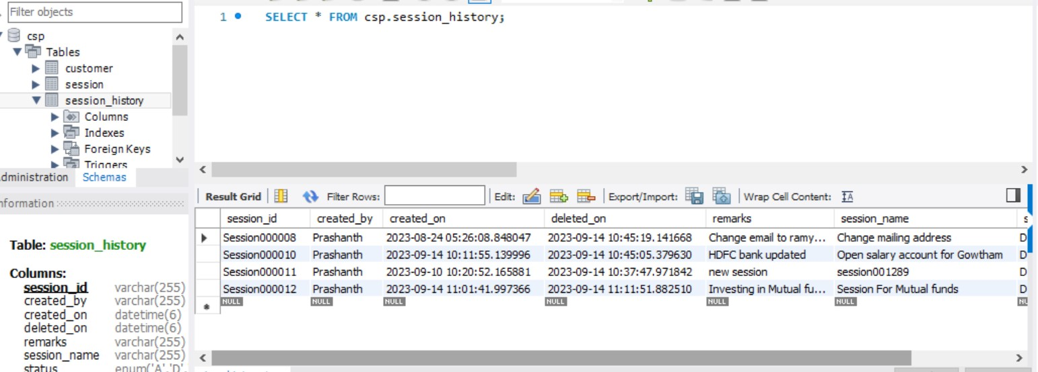
Citi Bank
Delete Session Delete Functionality: On Click of delete icon it will change the status of session from active to delete and store the same record in session history table.

Slide 12
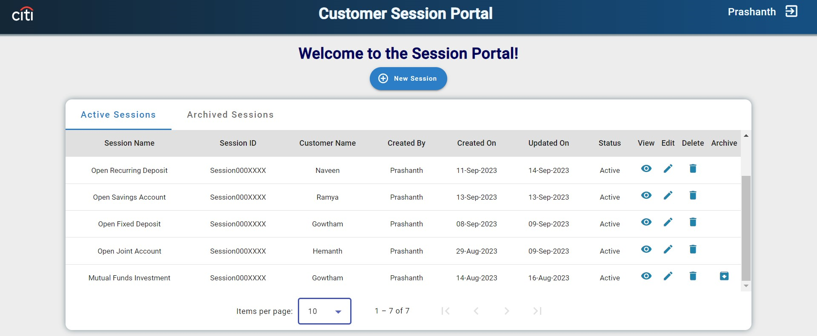
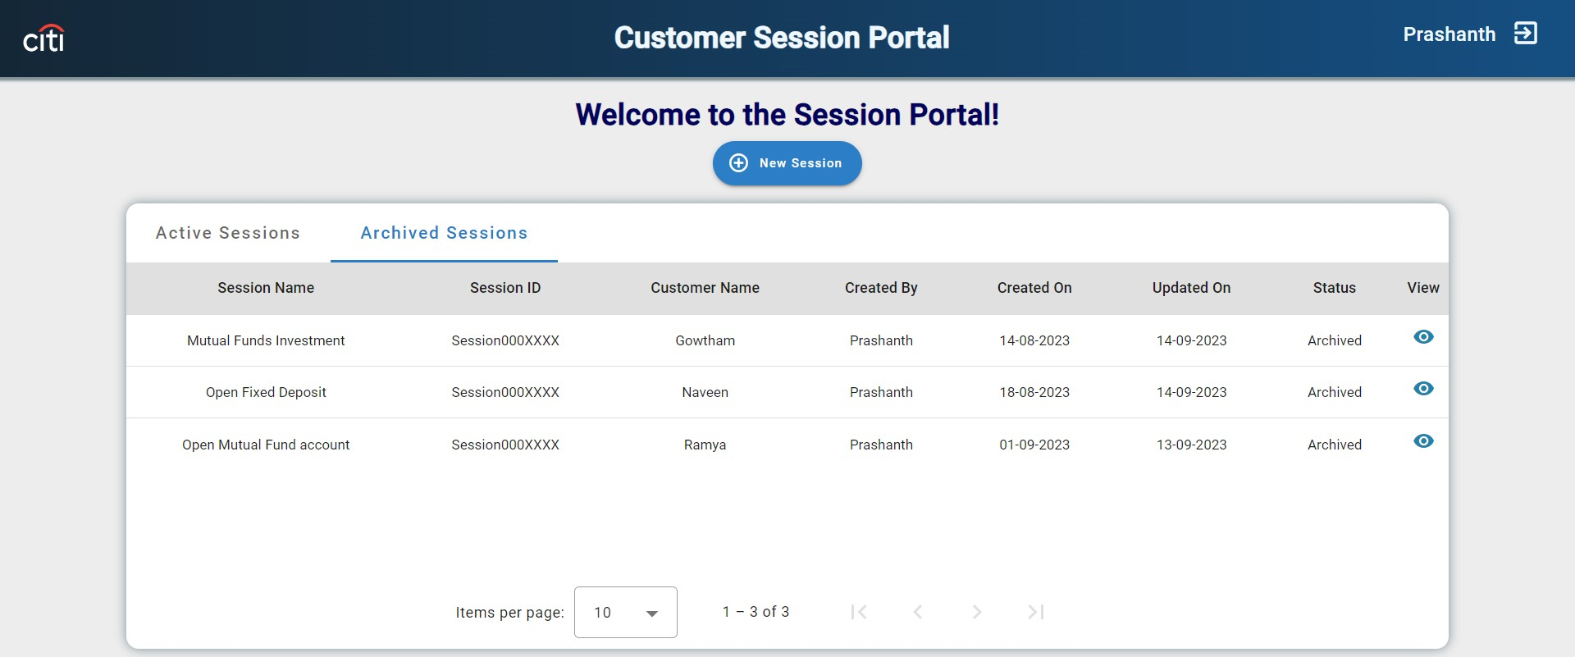
Citi Bank
Archive Session Archive functionality : If the difference between the updated date and current date is more than 10 days, then the session is eligible to archive.

Slide 13

Citi Bank
DEMO

Slide 14
Customer Session Portal - Deployment
SSH Key Creation
Login to Virtual Machine
Create a folder for frontend under in the below location: /home/thinknxt/gitLabCode/frontend or /backend
Create a ssh key in vm using following command: “ssh-keygen”
id-rsa.pub file will be created
“cat id-rsa.pub” to view the created file
Copy the ssh key and add it in gitlab folder in the VM

Slide 15
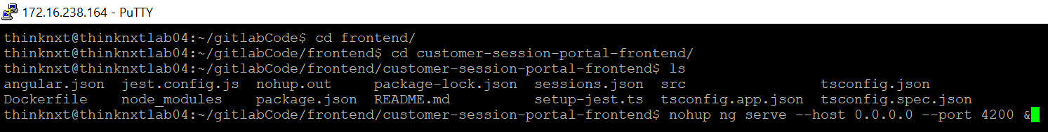
Customer Session Portal - Deployment
Front-End
Go to the Front-End folder where the Angular Application is present
nohup ng serve --host 0.0.0.0 --port 4200 &
“nohup” command is used to make sure the application is running in backend even if we exit from the VM
“0.0.0.0” IP is used to make sure external connections are able to access the 4200 port in VM

Slide 16
Customer Session Portal - Deployment
Back-End
Go to the Backend-End folder where the Java Application is present
Run this command to start the Java Application: “nohup java -jar /home/thinknxt/gitlabCode/backend/customer-session-portal-backend/target/project-charter-0.0.1-SNAPSHOT.jar &”
Navigate to “Logs” folder & Run “tail –f customer-session-portal.log” to see the running logs:

Slide 17


